Slide 1




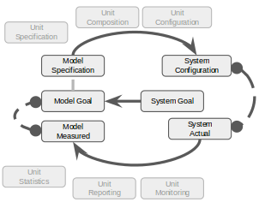
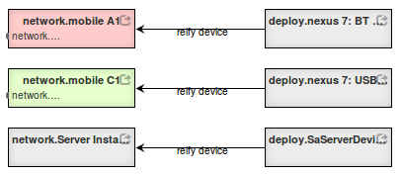
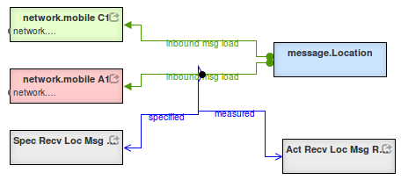
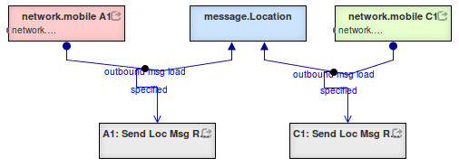
IMMoRTALS Ecosystem: Environment Definition
Doug Schmidt, Jules White, Fred Eisele
Institute for Software Integrated Systems / EECS Dept. / Vanderbilt University
Motivation and Goals
Principle Ecosystem Models
Current Effort
Adaptation of the Software System in response to Environmental Changes.
How to detect and coordinate changes between ecosystem models?
Component construction model
How are DFU’s composited to form components?
Deployment model
How are components are composited to form executables?
Network topology model
Along what paths are devices able to communicate?
Mission model
Where do topics originate and to whom are they directed?
DFU Composition
Negotiate interfaces for compositions by rings, pipes, calls.
Impact Analysis of Environmental Change across Modeled Systems
When the specified network bandwidth exceeds the actual, how to adapt?
Visualization and Perceptive Models
Graph based visualization —focus in context— .
Future Work
Approach
Cross-Cuts (Mega-model)
Graph Based Macro Templates for Implementation
Compose software elements by binding templates.
Archive templates as tree fragments.
Uniform Graph Based Representation of Artifacts
Repository with artifacts as graphs/trees.
Graph based visualizations.
Specification Based Verification
Use formally validated components when available.
Type-based checking.
Property based testing in simulated environments.
Specification using Models
Extensive traceability enabled by cross-cutting relationships.
Visualizations
Type-system examination and editing.
Impact analysis examination.
Initiate mediation activities.
Redundancy of Actual/Specified
Derived data retained in mega-model-graph for traceability and validation.
Composition
Unit Specification
Unit Configuration
Model Specification
System Configuration
Analysis of Models by Graph Traversal
Source code contain more information than needed for analysis —models strip away the incidental complexity— .
Source code lacks information for many types of analysis —integrating specification through annotations can help—
Conveniently retain inter-model relationships —Identify conflicts by examining cross cuts—.
Model Goals
System Goals
Model Measured
System Actual
Unit Statistics
Unit Monitoring
Reporting
Interfaces, Models and Monitoring for Resource Aware Transformations that Augment the Lifecycle of Systems (IMMoRTALS)
Notes:
I dropped the term “deployment model” as it has multiple and conflicting definitions.
Structural sharing may be used to reduce the size of the stored models.
The “braided-blivet” indicates the problem with un-reconciled models.
Each model individually seems consistent until they are brought together.
Moreover it may seem that the problem is a simple interface mismatch when it is additionally folded (i.e. complex).
Making a (travel ready) fabric poster.
http://labhacks.tumblr.com/post/62420107780/the-25-scrunchable-scientific-poster
https://support.spoonflower.com/hc/en-us/articles/204266984-How-to-Create-a-Fabric-Poster-from-a-PowerPoint-or-PDF
Size 7200px * 5400px = 4’ * 3’ @ 150 dpi
This can be done by saving as an SVG and then using Inkscape to resize.

Slide 2
Presentation Candidates
Notes:
These are intended to be included in the presentation.
The contain content from other external slides and the poster.

Slide 3


Environment / Mission Overview
Dynamic inputs (ecosystem model)
Environment
Mission Req
X …
X …
X ...
Static inputs
Resource DSL
Constructed System
Discovery
Analysis
Feature Model
App Model
f₁ * f₂
(g+h)
x
Permanent Store
Partial Annotations
DFU Types
r₁ {...}
r₂ {...}
@dfu
...
@dfu
r₁ {...}
r₂ {...}
@dfu
...
@dfu
r₁ {...}
r₂ {...}
@dfu
...
@dfu
The environment and mission motivate the design of the constructed system
Notes:
New mission requirement:
Secure the data-at-rest
Scale up number of users from 10^1 to 10^3
Identify a mapping between mission goals and technology and procedure.
Increase the number of mobile devices.

Slide 4

Modeling the Ecosystem
What is the ecosystem?
Why is the ecosystem important?
What have we done to model the ecosystem?
What next?
Adaptive demands originate from the ecosystem
Notes:
Modelling the ecosystem
What is the ecosystem?
The ecosystem consists of the environment and the mission goals and objectives.
Why is the ecosystem important?
The ecosystem is symmetric to the constructed system.
The ecosystem issues a set of challenges to which the constructed system responds.
We generate a set of specifications from the ecosystem models.
What have we done to model the ecosystem?
What next?
These two points are covered in the next slide.

Slide 5
Modeling the Ecosystem
Dynamic inputs (ecosystem model)
Environment
Mission Req
X …
X …
X ...
What is the ecosystem?
Why is the ecosystem important?
What have we done to model the ecosystem?
What next?
The ecosystem is everything that impinges upon the constructed system.
Notes:
Modelling the ecosystem
What is the ecosystem?
The ecosystem consists of the environment and the mission goals and objectives.
Why is the ecosystem important?
The ecosystem is symmetric to the constructed system.
The ecosystem issues a set of challenges to which the constructed system responds.
We generate a set of specifications from the ecosystem models.
What have we done to model the ecosystem?
What next?
These two points are covered in the next slide.

Slide 6
Modeling the Ecosystem
Dynamic inputs (ecosystem model)
Environment
Mission Req
X …
X …
X ...
What is the ecosystem?
Why is the ecosystem important?
What have we done to model the ecosystem?
What next?
Static inputs
Resource DSL
Discovery
Analysis
Constructed System
Feature Model
App Model
f₁ * f₂
(g+h)
x
Partial Annotations
Permanent Store
DFU Types
r₁ {...}
r₂ {...}
@dfu
...
@dfu
r₁ {...}
r₂ {...}
@dfu
...
@dfu
r₁ {...}
r₂ {...}
@dfu
...
@dfu
The ecosystem prescribes and specifies the constructed system.
Notes:
Modelling the ecosystem
What is the ecosystem?
The ecosystem consists of the environment and the mission goals and objectives.
Why is the ecosystem important?
The ecosystem is symmetric to the constructed system.
The ecosystem issues a set of challenges to which the constructed system responds.
We generate a set of specifications from the ecosystem models.
What have we done to model the ecosystem?
What next?
These two points are covered in the next slide.

Slide 7
Modeling the Ecosystem
What is the ecosystem?
Why is the ecosystem important?
What have we done to model the ecosystem?
What next?
Mission model
Where do messages originate?
To whom are they directed?
Build a mega-model including cross-cuts.
Notes:
Modelling the ecosystem
What is the ecosystem?
The ecosystem consists of the environment and the mission goals and objectives.
Why is the ecosystem important?
The ecosystem is symmetric to the constructed system.
The ecosystem issues a set of challenges to which the constructed system responds.
We generate a set of specifications from the ecosystem models.
What have we done to model the ecosystem?
What next?
These two points are covered in the next slide.

Slide 8
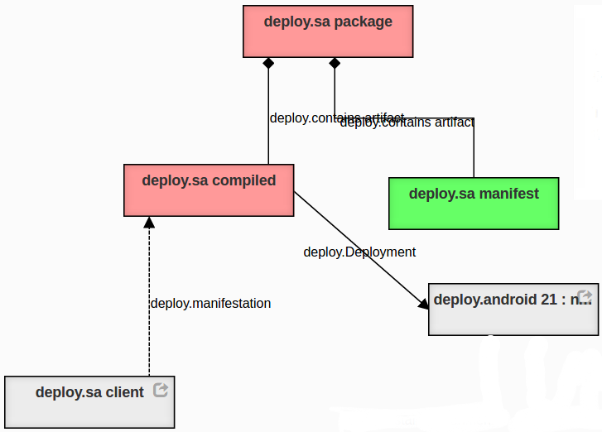
Modeling the Ecosystem
What is the ecosystem?
Why is the ecosystem important?
What have we done to model the ecosystem?
What next?
Component construction model
How are DFU’s composited to form components?
The components are assembled.
Notes:
Modelling the ecosystem
What is the ecosystem?
The ecosystem consists of the environment and the mission goals and objectives.
Why is the ecosystem important?
The ecosystem is symmetric to the constructed system.
The ecosystem issues a set of challenges to which the constructed system responds.
We generate a set of specifications from the ecosystem models.
What have we done to model the ecosystem?
What next?
These two points are covered in the next slide.

Slide 9
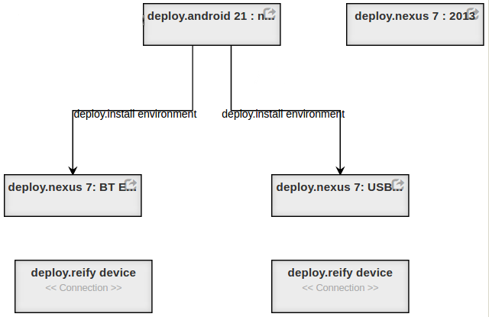
Modeling the Ecosystem
What is the ecosystem?
Why is the ecosystem important?
What have we done to model the ecosystem?
What next?
Package model
How are components are composited to form executables?
The components are combined to form packages for specific purposes.
Notes:
Modelling the ecosystem
What is the ecosystem?
The ecosystem consists of the environment and the mission goals and objectives.
Why is the ecosystem important?
The ecosystem is symmetric to the constructed system.
The ecosystem issues a set of challenges to which the constructed system responds.
We generate a set of specifications from the ecosystem models.
What have we done to model the ecosystem?
What next?
These two points are covered in the next slide.

Slide 10
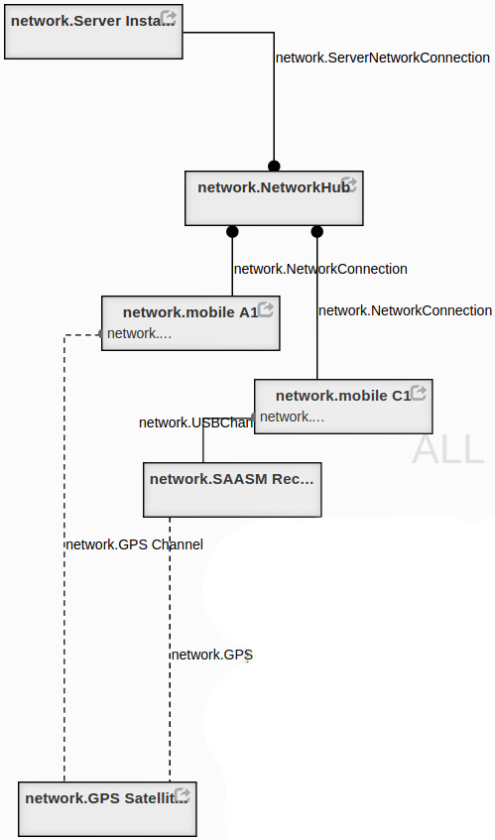
Modeling the Ecosystem
What is the ecosystem?
Why is the ecosystem important?
What have we done to model the ecosystem?
What next?
Network topology model
Along what paths are devices able to communicate?
The network names hardware and their locations.
Notes:
What have we done to model the ecosystem?
Discuss aspects of the “deployment-model” (ecosystem-model).
Discuss GME tool for modeling and generation of validation and construction artifacts.

Slide 11
Application of System Specifications
Modeling the Ecosystem
What is the ecosystem?
Why is the ecosystem important?
What have we done to model the ecosystem?
What next?
Generate script to deploy software to specific devices
Formal methods
Type systems (DSL)
Correct by construction
Property-based testing
Observation and measurement
Construct logger configuration to record and monitor key metrics.
The ecosystem mega-model specifies behavior for the constructed system.
Notes:
What next?
We generate a set of specifications from the ecosystem models.
These specifications can be used to verify the constructed system:
By formal methods
By type-systems
By correct construction (in-progress)
By property-based testing in simulated environments
By observation and measurement of fielded system
Property-based:
https://fsharpforfunandprofit.com/posts/property-based-testing-2/
https://www.youtube.com/watch?v=zi0rHwfiX1Q

Slide 12
Visualization and Perceptive Models
Graph based visualization —focus in context— .
Graph Based Macro Templates for Implementation
Compose software elements by binding templates.
Archive templates as tree fragments.
Specification Based Verification
Use formally validated components when available.
Type-based checking.
Property based testing in simulated environments.
Visualizations
Type-system examination and editing.
Impact analysis examination.
Initiate mediation activities.
Analysis of Models by Graph Traversal
Source code contain more information than needed for analysis —models strip away the incidental complexity— .
Source code lacks information for many types of analysis —integrating specification through annotations can help—
Conveniently retain inter-model relationships —Identify conflicts by examining cross cuts—.
The ecosystem mega-model specifies behavior for the constructed system.
Notes:
Some other candidates for future effort.
The braided blivet is an icon that expresses the fundamental problem.

Slide 13
Reference Slides
Notes:
These are ideas and reference material.

Slide 14
The Braided Blivet
What is the fundamental problem preventing adaptation?
Notes:
Conflicted-Complexity
The two models seem fine when considered separately.
But, when they are brought together something is not quite right.
Sometimes removing the cloud does not immediately reveal the problem.
This happens when the models are complected together.
(See “Simple Made Easy” Rich Hickey)
The easiest —and incorrect— thing to do is to conveniently forget that then are related.
This, then, is the key, do not forget the relationships between objects.
There are many types of relationships that are conflated:
the performance goals are not the same as the actual performance.

Slide 15
For the “control points” in the application, find out the DFUs that match the required functional spec
DFU
with required functional spec exists?
Not much we can do– the situation demands a functionality for which no implementation unit exist. Generating code for new functionality is not within our scope.
Is it possible to put two DFUs that we have to get what is needed? (Potential area of research?)
??
No
Deployment Target + Mission Requirement posted to DAS
Yes
We have a component that can do (functionally) what is needed, but its resource profile/dependencies do not match what is available
Provide change prescription for mission and deployment environment
Less interesting for BRASS
Provide change prescription for code
> Act on the change prescription for code
Catalog of domain specific transforms or mutations for altering resource usage
Works only on “system resources” i.e., CPU, Memory, Bandwidth and our tactical SA domain (Current/Active topic of research)
Act on the change prescription manually/negotiate requirement/ecosystem provisions
Less interesting for BRASS
For the DFUs that matched, check resource requirements
This is the basic logic of IMMoRTALS DAS.
Although described in terms of offline adaptation, a version of this executes for online adaptation as well– when we actually adapt code of the deployed application remotely** and not just behavior*
This workflow is general enough to consider constraints over attributes (representing QoS for example) of the EFS of the DFUs
*Runtime adaptation of behavior: Deployed code includes conditional branches
**Runtime adaptation of code that is not done remotely: Deployed code includes bytecode, libraries as well as a conditional loading/rewriting mechanism
DSL type checks?
Yes
No
Check PL and compiler issues
We have a component that can do (functionally) what is needed and its declared extra-functional spec matches what is available, but PL syntax, initialization and other dependencies are not satisfied
Provide change prescription for code
Act on the change prescription
Catalog of domain specific mutation/rewriting primitives that works for our chosen programming language and anticipated dependency issues (Future topic of research)
Act on the change prescription manually/negotiate requirement/ecosystem provisions
Less interesting for BRASS
Builds?
No
Yes
Check runtime issues
We have a component that can do (functionally) what is needed, its declared extra-functional spec matches what is available, and it compiles– some runtime dependencies were not met
Provide change prescription for code
Act on the change prescription
Catalog of domain specific mutation/rewriting primitives that works for our chosen runtime environment and anticipated runtime issues (Future topic of research)
Act on the change prescription manually/negotiate requirement/ecosystem provisions
Less interesting for BRASS
Runs?
No
Candidate variant (evolved) of the application is available
Additional topics of research on program rewrite/synthesis: (1) add conditional branches to support runtime adaptation of behavior (e.g., use this DFU vs the other DFU); (2) equip applications to do non-remote code adaptation
Notes:
15

Slide 16
Validation and Testing Spectrum : Specification
Goal
Precise
Rich
Integrated
Formal Methods
If you have components which have been formally verified you should use them.
Type Systems
If you understand the system well enough to develop a type system; you should develop one.
Specification Guided Randomized Testing
Simulate and environment which exercises every aspect of the specification.
Notes:
http://www.cis.upenn.edu/~bcpierce/papers/clojure-deepspec-2015.pdf
Formal Methods (precise)
Type-Systems (light-weight formal methods)
Property-Based Testing
http://www.ontestautomation.com/an-introduction-to-property-based-testing-with-junit-quickcheck/
https://github.com/pholser/junit-quickcheck
In each case the specification is used to validate the system.
Models must express the specification.

Slide 17
Workflow
Export2 FORMULA
Check FORMULA
Formula Docker Container
Model translation (Formula Editor initiates towards WebGME that executes Export2FORMULA plugin and respond with a link to the Formula domain and model with the user defined constraints)
Constraint checking (Formula Editor initiates towards WebGME that executes CheckFORMULA which uses the Formula webservice that gets the result of step 1 and runs it on a docker container and responds with the true/false result per constraint)
SERVER
WebGME
Formula webservice
Formula Editor
Model Editor
Meta Editor
CLIENT
WebGME UI components

Slide 18
Minimal Architecture
Server Machine
MongoDB
Worker
Interprocess
Websocket
HTTP
WebGME
Formula webservice
HTTP + Websocket
In the smallest deployment configuration all the necessary processes can live on the same machine on the server side. Allowing a quick yet fully functional deployment.
Client Machine

Slide 19
Scaled Architecture
MongoDB
Webgme
Formula webservice
worker
docker
Webgme
Formula webservice
worker
worker
docker
Webgme
docker
worker
Formula webservice
worker
worker
docker
docker
Webgme
docker
worker
Formula webservice
worker
worker
docker
docker
docker
worker
worker
docker
docker
worker
docker
Webgme load balancer
Formula load balancer
Individual parts of the system can be scaled independently to serve as many clients as needed.
Client Machine

Slide 20
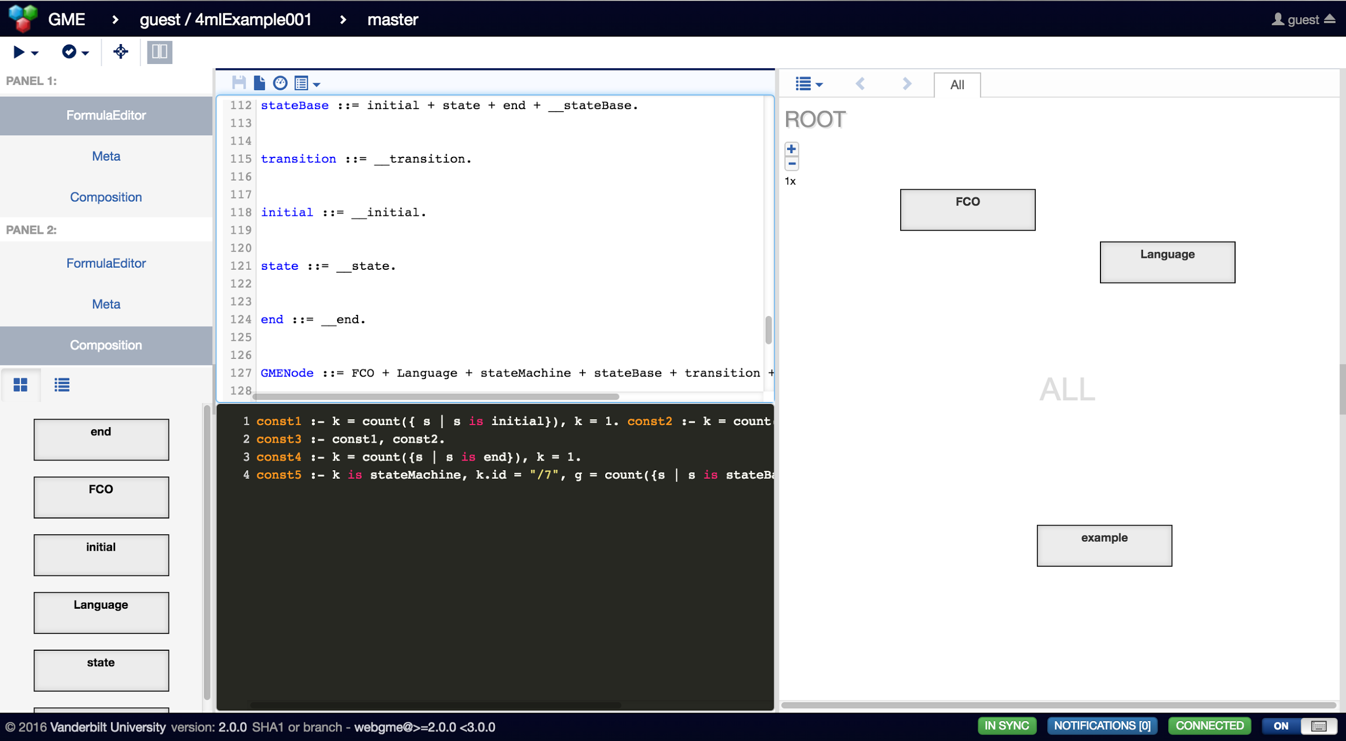
Integrated User experience
Formula Editor
Model Editor
Live Formula domain representation of the WebGME projects’ language
Textual editor to define constraints

Slide 21
http://www.dre.vanderbilt.edu/~schmidt/PDF/MW-Spl.pdf

Slide 22
Domain specific feature model
Vocabulary required to describe/analyze/synthesize applications: data, data manipulation capability and organizing units. We specialize our vocab for our platform– tactical SA. In the following, the CamelCase terms are defined in our ontology.
The data our platform manipulates are:
SAData and its various specializations LocationData, ImageData…
Our data manipulations are
ProduceSAData, SendSAData, ReceiveSAData, ConsumeSAData,…
ProduceLocationData…
ProduceImageData…..
Our organizational units are
SADataProvider and its specializations such as LocationProvider, ImageProvider
SADataWriter and its specializations such as NetworkWriter, FileWriter, (StreamWriter? ObjectWriter to indicate that they write to the next stage or object in a pipeline?),
SADataReader and its specializations such as NetworkReader, FileReader
The vocabulary is deliberately made bushy (SAData and its children). Further specialization is modeled in terms attributes related to functional specification such as a LocationDataProvider with (accuracy > 1meter) , (authentication = yes AND encryption = yes) etc. as opposed to further specialized children of LocationDataProvider such as AccurateSecureGPSLocationProvider (or explicitly named like SAASMLocationProvider).
This has the advantage that the attributes and predicates on attributes map intuitively to our refinement types [? Eric?]
How flat or bushy should the functional spec semantics be?
SPL/PLA assumption: Code is organized/structured in terms of the Feature Model
Functional spec assumption: functional specification is given, Extra functional spec is discovered.
The concept of DFUs:
DFUs represent organizational units. Each DFU has a number of data manipulators.
The assumption “functionality is given” implies that we have annotations (in code or outside) that describes the functional spec of code units
Point of Definition: This unit (e.g., function) is defining the “ProduceLocationData”
Point of Use: This unit (e.g., a line) is instantiating a LocationProvider, or invoking “ProdceLocationData”
Our evolution is in terms of DFUs:
Substitution and modification at points of use: DFU instantiation, invocation of data manipulators provided by DFUs
Modification of points of definition: results in new DFUs
Control Point Assumption: Not every line of code in the application is evolvable, nor is it required. For our platform– the control points are what that can evolve
Control points collectively represent a specific strict subset of the application
Have sufficient functional spec for both definition and use
Note: If functional spec of the definitions are given, we may discover the point of use by program analysis. This will probably work better if we have a really flat hierarchy of functional spec (option A on the left)
SAData
SAData
SAData
LocationData
Option A. Only the root is needed– everything else is captured in properties, properties of properties
LocationData
SecureLocationData
….
Option C. Arbitrary number of layers and no properties
ImageData
ImageData
Option B. 2 layers and Properties
SecureImageData
….
Notes:
22

Slide 23
Unit Composition
Unit Configuration
Unit Specification
Model Specification
System Configuration
Model Goal
System Goal
Model Measured
System Actual
Unit Statistics
Unit Reporting
Unit Monitoring
Adaptation Under Change Pressure
Notes:
The system-goals translate into model-goals or specific-model-metrics and their expected values.
The model-goal implies some model-specification that is expected to achieve the model-goal.
The model-specification needs to be translated

Slide 24

Purple dotted: observations sent back from platform to DAS BE (at runtime) and updates sent back to platform from the DAS BE
Experiment Control Network
Immortals DAS Backend Server
ATAKLite
ATAKLite
Marti
ATAKLite
ATAKLite
ATAKLite
Platform: Android clients and Marti Server
LL Interface
Red: affect change
Furnish new deployment environment description and mission requirement
Example:
Target environment does not have GPS satellite signal, there will be 10 clients each sending 1 KB update every minute
Green: Read effect
Example:
Whether a new variant was produced or not
Red: affect change
Manipulate resource state at runtime
Example:
Network bandwidth went down, GPS signal lost, CPU load went high
Green: Read effect
Example:
Clients failing to get update, or failing to publish updates
Notes:
24

Slide 25
Understanding Intent:
Functional Intent: The ATAKLite client and Marti server have their own functional intent:
ATAKLite: publish and consume SA data
Marti: serve published SA data to subscribed clients
How can LL check Functional Intent:
Run platform applications, have clients publish SA data and see if subscribed clients get them
Resource Intent:
The applications have an expectation of resources that they need, and the target deployment
environment provides a set of resources
How can LL check Resource Intent:
Set the platform resources as specified and see if the functional intent is met
Vary the platform resources and see what the impact its
Mission Intent:
Constraints over functional intent—that the clients publish this frequently, or this size, or needs
this level of accuracy or security
How can LL check Mission Intent:
Set the platform as specified and see if the functional intent is met
Vary the platform– i.e, have a client try to connect w/o authentication, or make higher or lower accuracy GPS data available, have a client publish more frequently and see what the impact is
This approach should work whether we adapt Offline or Online– and will likely help them cross of over the apparent semantic barrier they have with our stuff and the rest of the performer (that seem to offer manipulation of runtime conditions)
Notes:
25

Slide 26
Specification
Rich : how much is the specification capable of saying?
Formal : can reason about it?
Integrated : it is part of the code?
Notes:
Rich : how much is the specification capable of saying?
Formal : can reason about it?
Integrated : it is part of the code?
We use DSL, Ontology and Models to specify the system.

Slide 27
Test
SUT A
SUT B
SUT C
SUT D
Op #1
Op #2
Op #3
Obs #1
Obs #2
Obs #3
Model A
Model B
Model C
Txn #1
Txn #2
Txn #3
A failed test
Notes:
https://youtu.be/Y2jQe8DFzUM?list=PLZdCLR02grLrl5ie970A24kvti21hGiOf
A Deep Specification for Dropbox - Benjamin Pierce
A specification is a model representing a system-under-validation.
And if validation is done by testing then a system-under-test, SUT.
QuickCheck
http://www.quviq.com/index.html
http://www.eecs.northwestern.edu/~robby/courses/395-495-2009-fall/quick.pdf

Slide 28
System Under Test/Demo
Each partner should have an instance
Much of the system should be generated
Macro-programming
Minimize/eliminate raw text
Notes:
Vanderbilt will stand up a copy of the system that we deliver to Lincoln Labs We will investigate converting some of the scripts into templates which will be instantiated using information from models. This is a macro-programming approach.
Targeting a different template enables several forms of adaptation:
alternative construction, e.g. changing of a set of compiler options
scaling and variation, e.g. provisioning to multiple devices and execution-environments
negotiation of api's , (dynamic selection of interface specifications)
composition for emergent behavior
Steps:
Perform all of the tasks described in "brass/immortals/README.md"
Configure DAS "brass/immortals/das/README.md" brass/immortals/das/docs/environment_installation.md brass/immortals/das/docs/server_documentation.md
Run the actions described in the
brass/immortals/das/das-service/readme.txt

Slide 29
Use Cases
Notes:
Some situations that would suggest adaptation.
Android bugs
Android evolution
Mobile domain examples

Slide 30
Android Bug
Examples
Bluetooth beacon resource leak
Heart-bleed
Approaches
Backport
Work-around
Repaired version
No-fix
Notes:
http://www.androidpolice.com/2014/05/20/bug-watch-bluetooth-will-begin-crashing-after-encountering-too-many-ble-devices-affects-kitkat-4-4-and-jelly-bean-4-3/
The bug needs to be accommodated.
The work around involved adding code and cycling the bluetooth stack based on some trigger.
An example trigger could be when you get near the limit of the number of bluetooth devices.
A bug-fix could be made available via:
a backport or in a new version or a work-around or nothing.
Heart-bleed replace the server.
https://en.wikipedia.org/wiki/Heartbleed

Slide 31
Android Variability
AsyncTask thread model
Permissions model
File access rules SD-Card, etc.
UI design principles : material design
Feature/API availability
Full Disk Encryption availability
https://developer.android.com/topic/libraries/support-library/features.html
Notes:
These indicate the evolution of the android platform.
There is a relationship between feature-goals and platform-features.

Slide 32
AsyncTask Variability
Donut
Single Thread
Thread Pool
Honeycomb
Notes:
AsyncTask
https://developer.android.com/reference/android/os/AsyncTask.html
When first introduced, AsyncTasks were executed serially on a single background thread.
Starting with DONUT, this was changed to a pool of threads allowing multiple tasks to operate in parallel.
Starting with HONEYCOMB, tasks are executed on a single thread to avoid common application errors caused by parallel execution.

Slide 33
Permissions Granularity
Marshmallow
Static All Permission
Dynamic Permission Grain
Notes:
https://people.eecs.berkeley.edu/~dawnsong/papers/2011%20Android%20permissions%20demystified.pdf
The original architecture presumed apk’s had a few permissions.
Actual usage turned out to include many permissions that were not required for core application functionality.
This means more granular exception handling as any permission may be disallowed.
More checking would be needed to wrap the DFU.

Slide 34
SD Card Access
KitKat
Global Access
Application partitioning and permissions
Notes:
http://androidforums.com/threads/sd-card-write-permission-issue.893804/
Originally the SD card was treated as a bus of sorts.
Actual usage turned out to include more desktop type behavior.
Is the sd-card being used as a cache or a communication channel?
This requires carrying information about the use.

Slide 35
Bad Guy Recognition
E.g. suppose algorithm needs face only
Camara
CPU
Memory
Algorithm
Network
Notes:
Network bandwidth
Cpu
Camera
Memory
Recognition algorithm
Upload to server via proxy DFU
Use GPU extra-functional
Scale image high res camera, low res network, low power cpu.
Other types of downsampling, color, zone-on-image, compression jpeg
Feature-detectors and feature-descriptors, analysis prior to sending over network.
When displaying image, do stuff to draw attention, adaptive user experience.

Slide 36
Blue Force Location
Notes:
Secure or not.
GPS satellite available or not.
Dead reckoning.
Wifi-based location determination

Slide 37
extra-functional-behavior
Round trip analysis versus local processing.
Adapt a long-running but feature correct DFU to meet strict run-time-guarantees.
65k limit on methods in a single apk, composition of DFU.
Exclude DFU if it requires security hardware that is not available.
Notes:
extra-functional-behavior When a DFU meets the functional requirements but fails on some performance requirement.
Mutation testing could be used in this space.

Slide 38
Adaptation Approaches
Notes:
Adaptive Approaches Vanderbilt will consider model-based approaches to each of the following: Compat library.
https://developer.android.com/topic/libraries/support-library/index.html
https://developer.android.com/topic/libraries/support-library/features.html
By Transformation
By Substitution
Give some good examples for the adaptations.
Transformations in addition to substitution.
Blending logger DFU with encryption library first demonstrate by hand and then automatically.
Logger generates trace for simulator.
Bluetooth stack bug related to resource leak beacon.
SCard everybody can read.
AsyncTask implementation changed.
Take advantage of all or nothing permission change.
65k limit on methods in a single apk , composition of DFU.
Exclude DFU if they require security hardware that is not available.
Full disk encryption as a DFU when not available in system.
Round trip analysis versus local processing, image vision.
Any of the back port library .
Cert security lists.

Slide 39
Straight up substitution : multi-constraint-knapsack
Swap one type of encryption for another
Notes:
Straight up substitution
This is the substitution approach which is the basic approach for the system.
This involves examination of strongly typed interfaces.
The weakness in this approach is due to:
Brittle interfaces
Typically specified with lower level abstractions
Unclear mappings of representation,
E.g. system A’s properties are represented by a dictionary.
Overly specific specifications (trie can help)
ontology problems
unhelpful hierarchies
single tree ontology

Slide 40
configurable-system
The adaptation is anticipated.
The anticipated adaptability never materializes.
First generation middleware frequently introduces incidental complexity.
Care must be taken to keep the middleware “light”.
Optimizers can be constructed that eliminate unused flexibility.
Trivially a compiler unrolls loops
Notes:
configurable-system This is an approach where the adaptation stressors were profoundly anticipated.
This is the approach taken in the AMMO project.
The difficulty here is that not all dimensions for adaptation are included.
There is incidental overhead associated with middleware.
http://www.dre.vanderbilt.edu/~schmidt/PDF/MW-Spl.pdf
Sometimes carefully constructed middleware can surpass that of custom applications but in the short run there are usually performance issues.
C-compilers now routinely beat all but the most carefully written assembly-language.
Maybe we should be investigating middleware-optimization?

Slide 41
negotiated-interfaces
Logger generates trace for simulator.
Notes:
negotiated-interfaces or goal-directed-interface
When DFUs are required to interact but their interface specification are incompatible.
This will typically be the result of applying the knapsack approach at a functional level rather than at the strongly typed programming interface.
https://vimeo.com/71278954#t=834s
Man-Computer Symbiosis: 5.4
http://groups.csail.mit.edu/medg/people/psz/Licklider.html
“Computer instruction through specification of goals is being approached along two paths.
The first involves problem-solving, hill-climbing, self-organizing programs.
The second involves real-time concatenation of preprogrammed segments and
closed subroutines which the human operator can designate and call into action simply by name.”
Consider FACE

Slide 42
blended-behavior
Blending logger DFU with encryption library first demonstrate by hand and then automatically.
Notes:
blended-behavior When compositions of DFUs are capable of providing a required blended-functionality.
If the DFUs have incompatible interfaces this may trigger a negotiated-interface adaptation.

Slide 43
emergent-behavior
Good Karma
Serendipity <pretty rare>
Design patterns
Bad Karma
Bluetooth stack bug related to resource leak beacon.
SCard everybody can read.
AsyncTask implementation changed.
Changes in resource permission.
Notes:
emergent-behavior When compositions of DFUs are capable of providing a required non-obvious functionality.
While these are not automatically discovered they can be formally specified as can their application environment.
Usually unplanned+non-obvious or emergent behavior is a bug but occasionally it will produce a favorable, typically dynamic, behavior.
When favorable emergent-behaviors are identified they should be recorded, and they frequently are.
They are patented, compiled (as design patterns) or formally proven as theories, the discovery or invention of these systems constitute progress in a domain.
Factory pattern
Proactor pattern
Inversion of control for reusable modules
etc.
Bluetooth Bug for BLE:
http://www.androidpolice.com/2014/05/20/bug-watch-bluetooth-will-begin-crashing-after-encountering-too-many-ble-devices-affects-kitkat-4-4-and-jelly-bean-4-3/
SDCard permission
Prior to Android 4.4 KitKat, applications, only needed an all-or-nothing permission to access the external SD card.
That permission included read and write to any area on removable storage, SDCard.
This included the system folders like DCIM, Alarms, etc.
Now third-party applications can only write to files and folders that they have created or own.
http://technofaq.org/posts/2014/04/fixing-external-sd-card-write-issue-on-android-kitkat/
This opens another issue with apk’s which expect to be able to communicate using this mechanism.
resource-permission changes
The Android permission system is problematic for a number of reasons.
They started with a coarse all-or-nothing model.
http://www.howtogeek.com/177904/androids-permissions-system-is-broken-and-google-just-made-it-worse/
This was improved upon by a more a-la-carte approach.
https://fpf.org/2015/06/23/android-m-and-privacy-giving-users-control-over-app-permissions/
But some permissions are granted without asking at all.
http://www.routercheck.com/2016/02/09/its-time-to-demand-accountability-of-android-apps-permissions/
http://www.routercheck.com/android-permissions/
In order to get granular permissions the multi-permission-apk could be decomposed into
individual apks (the original android model) or specific apks composed of only the relevant DFU.
Now with finer grain control over permission these can be configured during provisioning.

